Slide 1
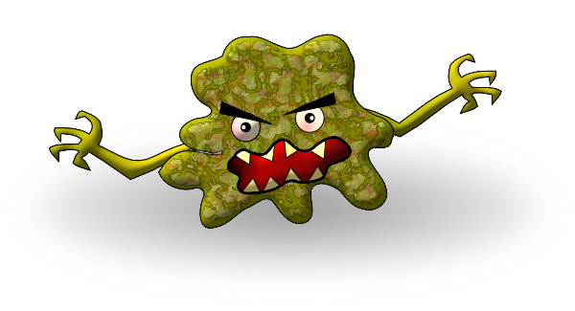
Wash your hands.
Cover your coughs and sneezes.
Do not share anything that has been in your mouth.
Snake & Ladders master to be copied for students – see lesson plan in pack for instructions.

