Slide 1
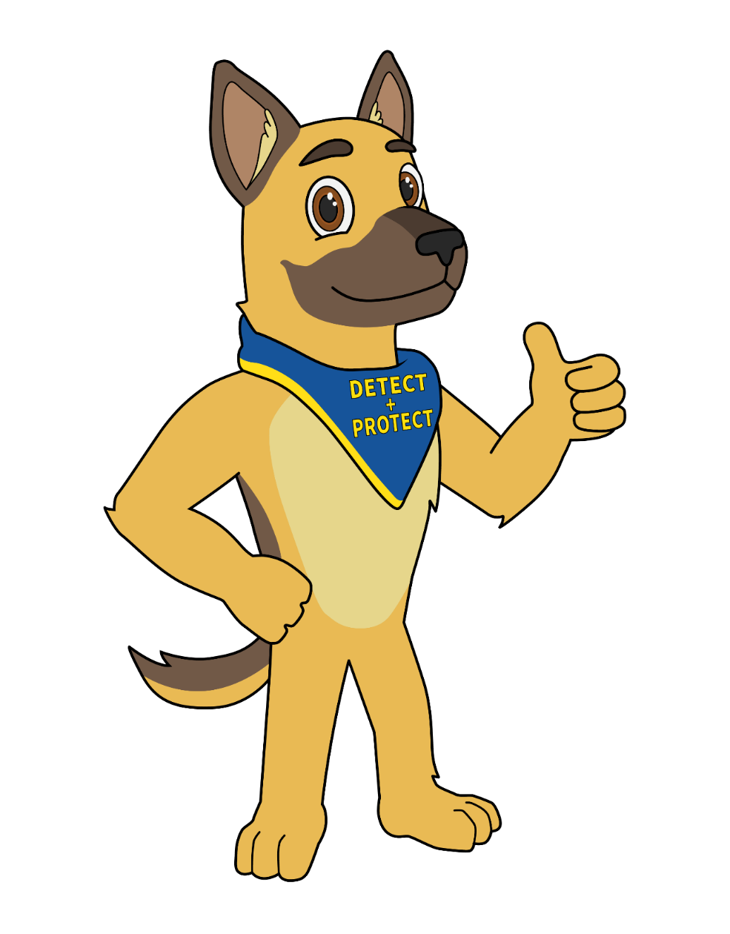

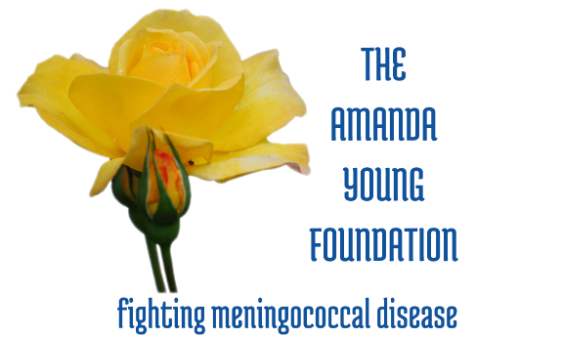
The Amanda Young Foundation
Detect + Protect
Buddy will help you take care of your health by showing you how to DETECT bacteria problems and how to PROTECT yourself.

Slide 2

Who is Buddy?
Buddy is
Strong
Clever
Protective
Great Detective
and is here to help you stay healthy.

Slide 3
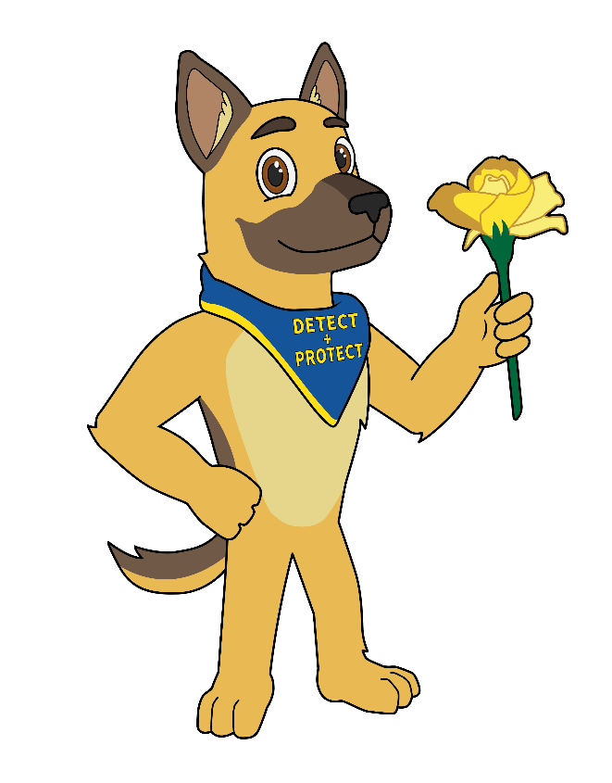
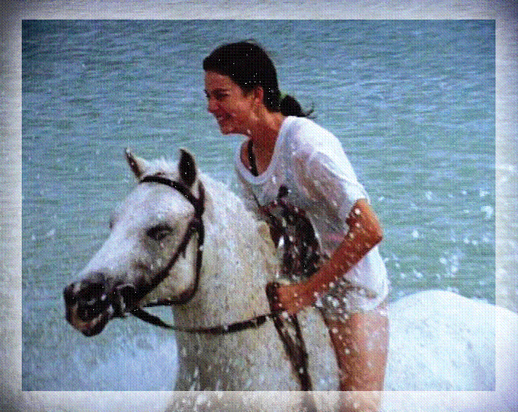
Detect + Protect
Buddy lived with the Young family many years ago. Barry and Lorraine Youngs’ daughter, Amanda Young, was sick with meningococcal disease in 1997. The Youngs started The Amanda Young Foundation in 1998 to educate Western Australians about this disease.

Slide 4

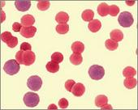
MENINGOCOCCAL
Let’s take a quiz…….

Slide 5



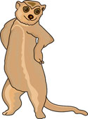
QUIZ
A - raise your right hand
B - put your hands on your hips

Slide 6

Question 1
What is bacteria?
a. An organism found on all living things
A chemical

Slide 7
Question 2
What is Meningococcal?
a. A type of bacteria that can cause a serious disease
b. Something found in water

Slide 8

Question 3
What do you think will happen if you get meningococcal disease?
You will need to rest for 24 hours
You will feel sicker than you have ever before and will need to go to hospital

Slide 9

Question 4
What should you do if you think you have meningococcal disease?
a. Tell a trusted grown up you feel very sick and need to see a doctor
b. Go to bed and rest

Slide 10
Question 5
What do you think is our main motto?
Be aware, don’t share!
Let’s play and keep bugs away!

Slide 11
Question 6
Is meningococcal disease ………?
Rare (less than 300 cases in Australia)
Common

Slide 12
Question 7
Meningococcal disease can be treated with antibiotics……….True or False?
True
False

Slide 13
Question 8
Meningococcal bacteria are passed by:
Dust particles
Mucus particles

Slide 14
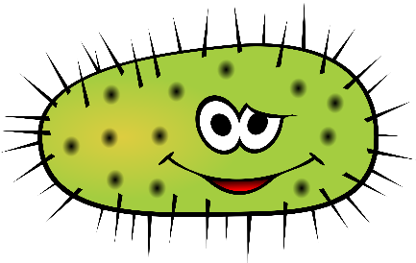

Meningococcal is a bacteria not a virus
Meningococcal infections need antibiotics and treatment in hospital
Meningococcal Disease is RARE
Meningococcal Bacteria are found in the mucus at the back of your throat and nose
Be Aware – Do Not Share anything that has been in your mouth

Slide 15

How many types of bacteria
live in our mouth?
?

Slide 16





GOOD bacteria
OVER 700 types!
OVER 7 billion in number.
BAD bacteria
Healthy
MENINGOCOCCAL
Sick

Slide 17

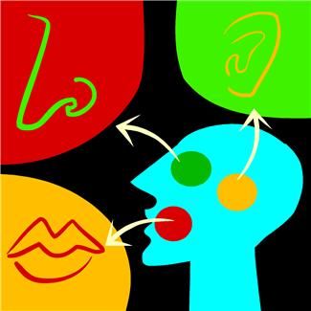
Mystery bag – to share or not to share –
that is the question!

Slide 18
How many bacteria can you see on the following slides? SLIDE 1

Slide 19
How many bacteria can you see on the following slides? SLIDE 2

Slide 20


Slide 21



21

Slide 22
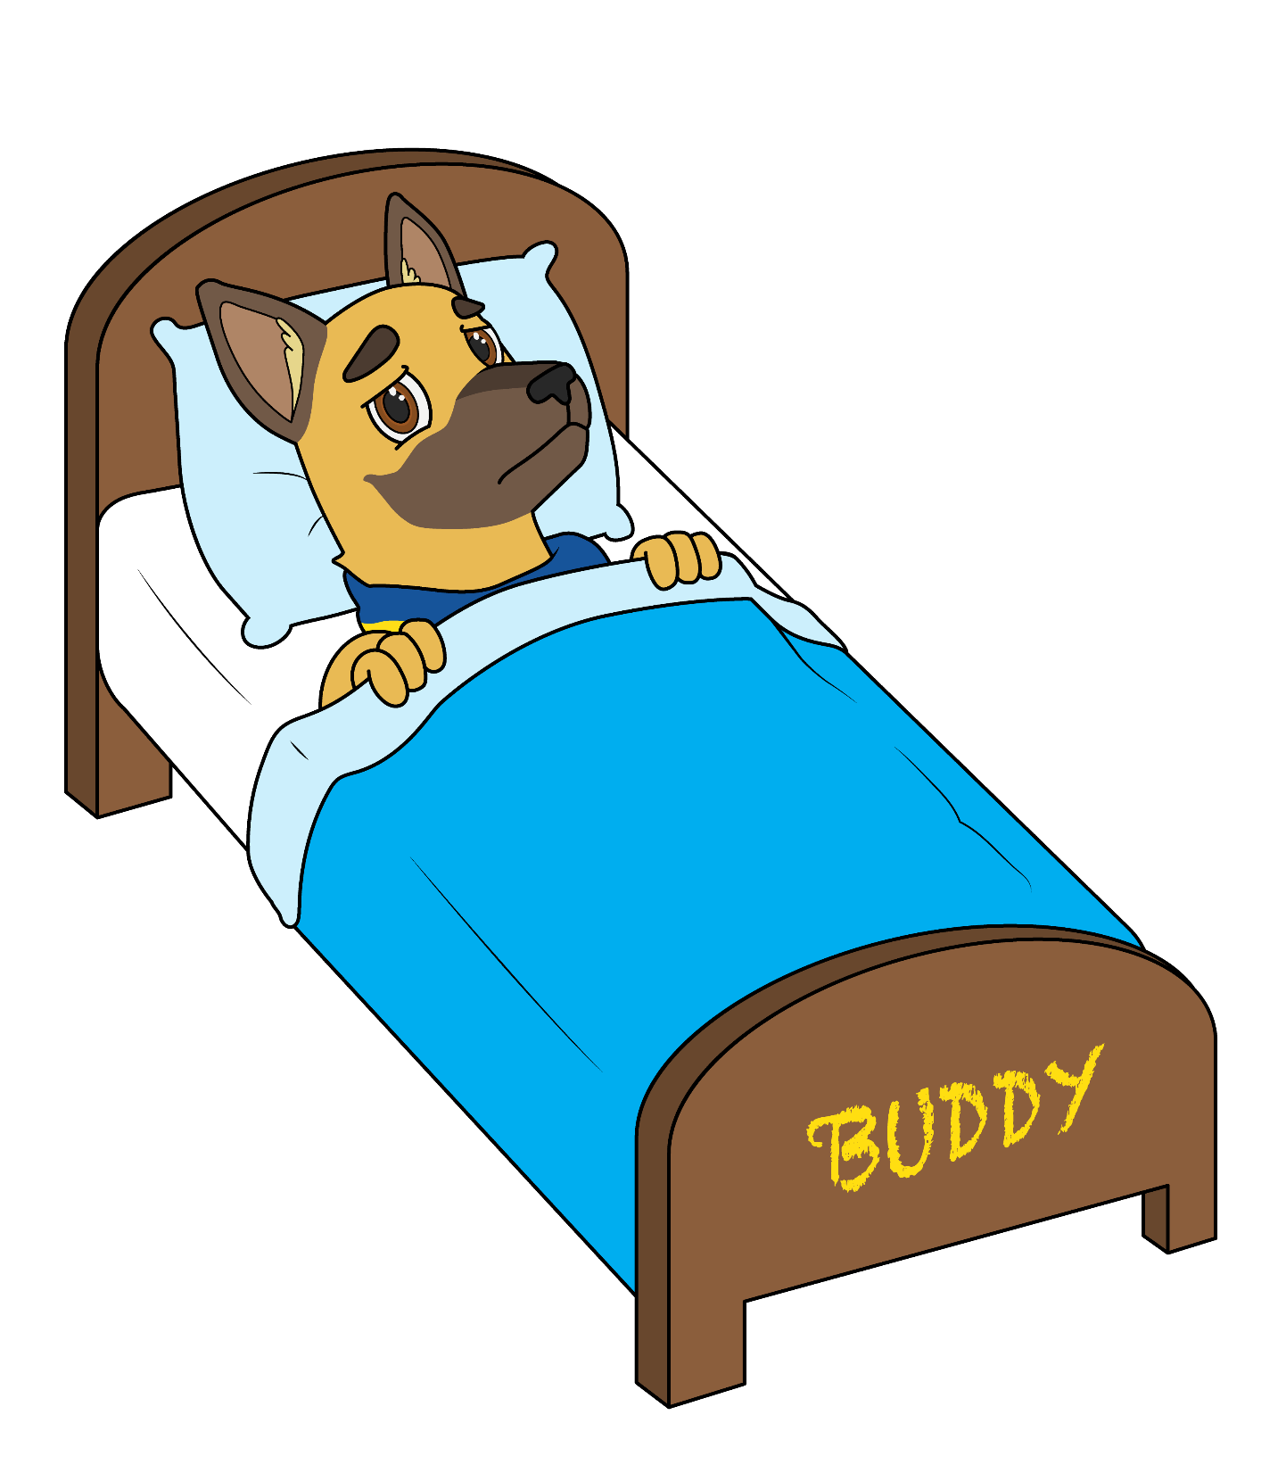
Symptoms of Meningococcal Disease

Slide 23
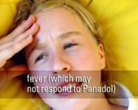
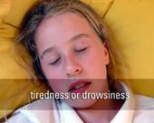
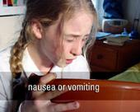
Muscle ache
Cold hands and feet
Headache
Spots or marks on the body

Slide 24
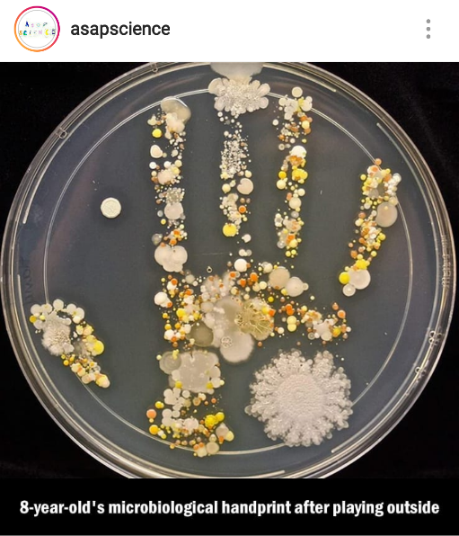
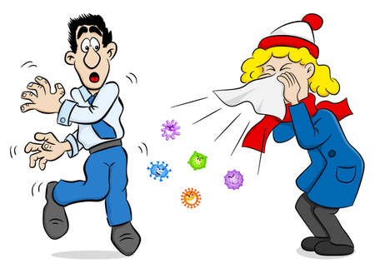
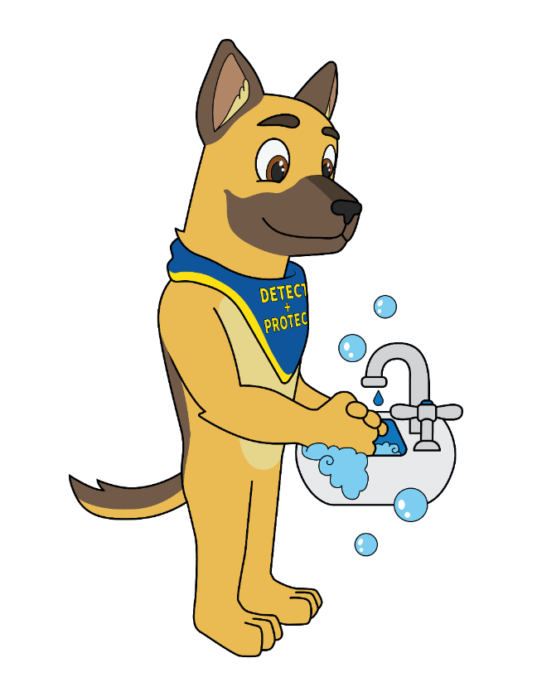



Slide 25
Wash, wash, wash your hands
Rub and scrub them clean
Count to twenty
That is plenty
Remember in-between.
(Sing 3 times)

Slide 26
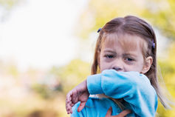
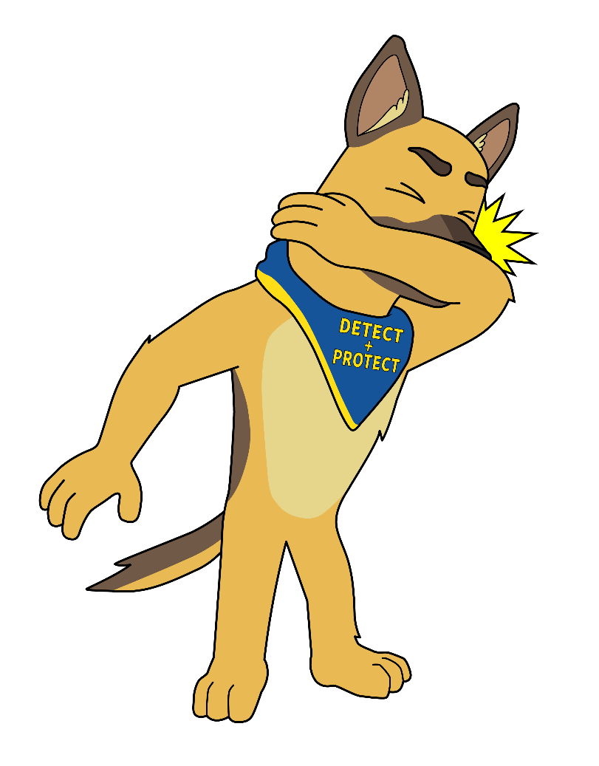
Men – ingo – coccal
Men – ingo – coccal
Where - are - you?
Where - are - you?
At the back of your throat
And inside of your nose
A – tish - oo!
A - tish - oo!
Men – ingo – coccal
Men – ingo – coccal
What - to - do?
What - to - do?
Be aware and do not share
Anything from your mouth
Bac – teria - Shoo
Away - from - you!

Slide 27
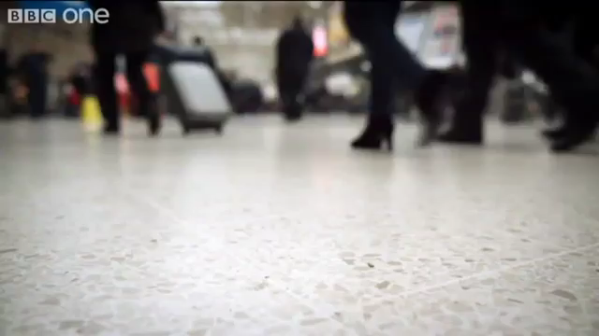

Slide 28
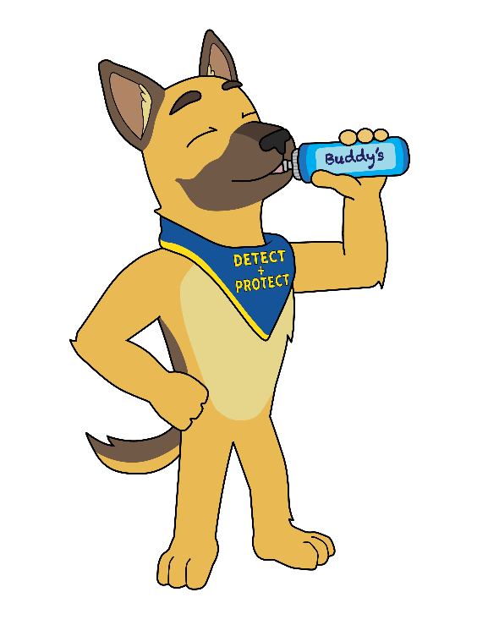
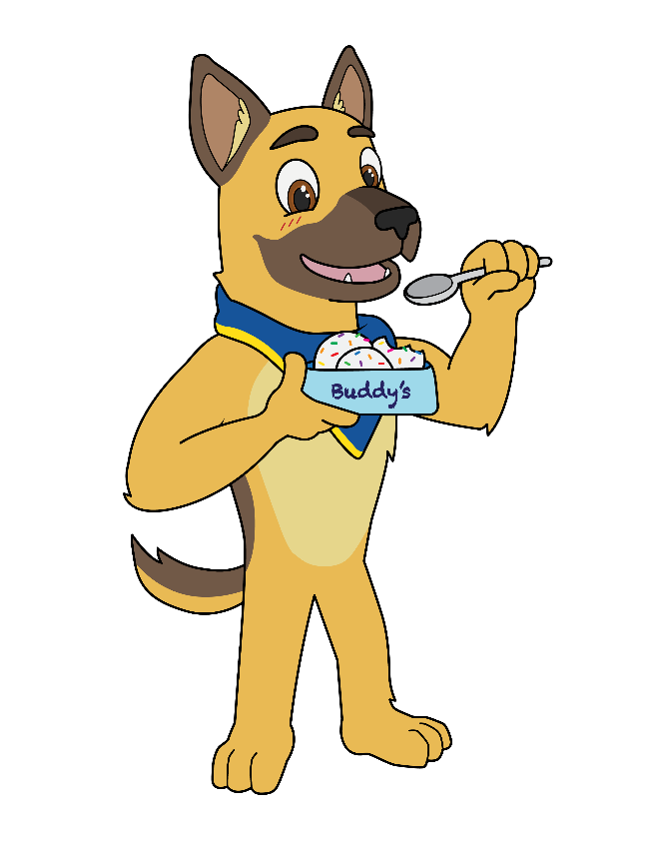
Cover your coughs and sneezes
Wash your hands for 20 seconds
Stay home if you’re sick
Tell an adult when you feel unwell
Do not share anything that has been in your mouth

Slide 29
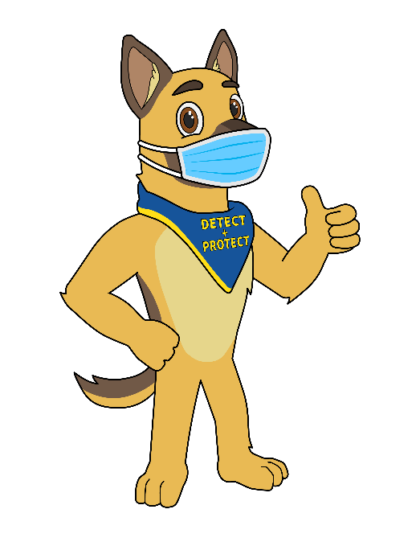
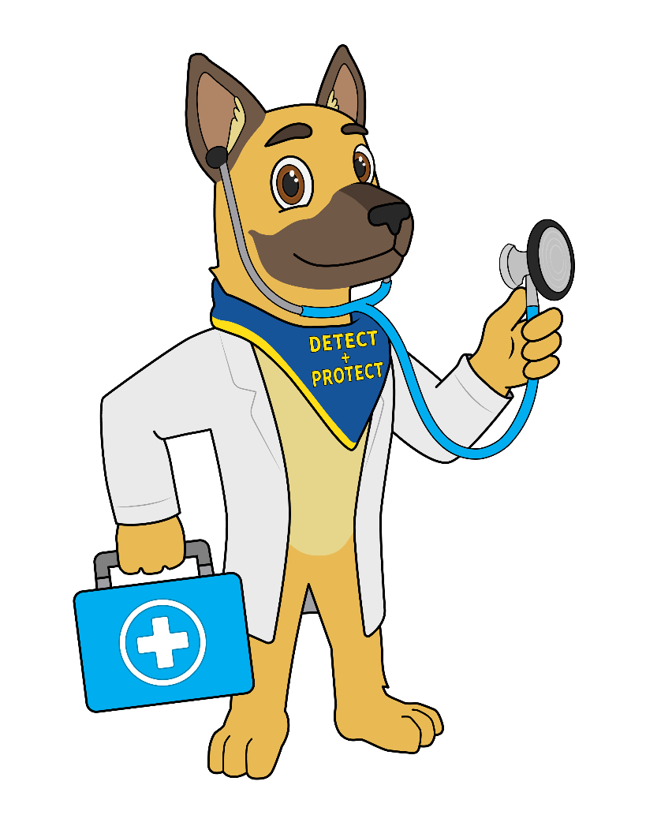
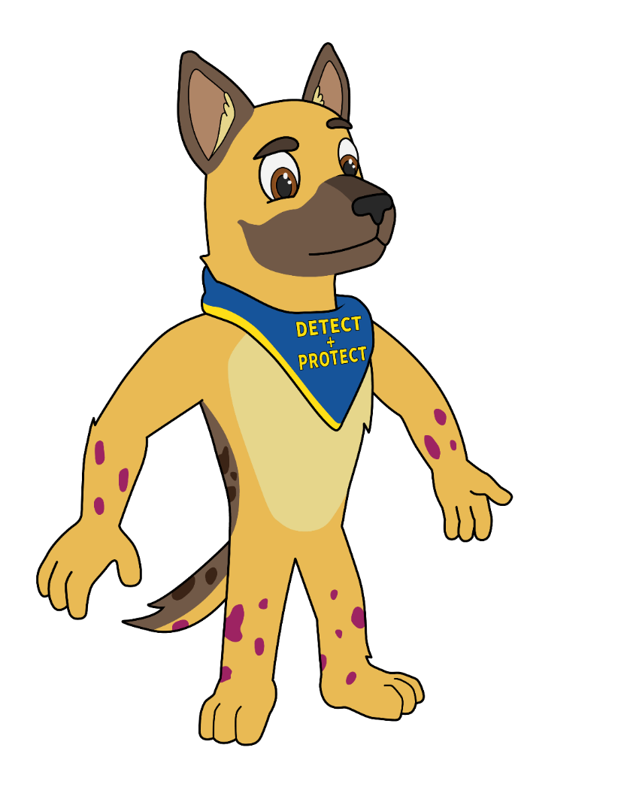
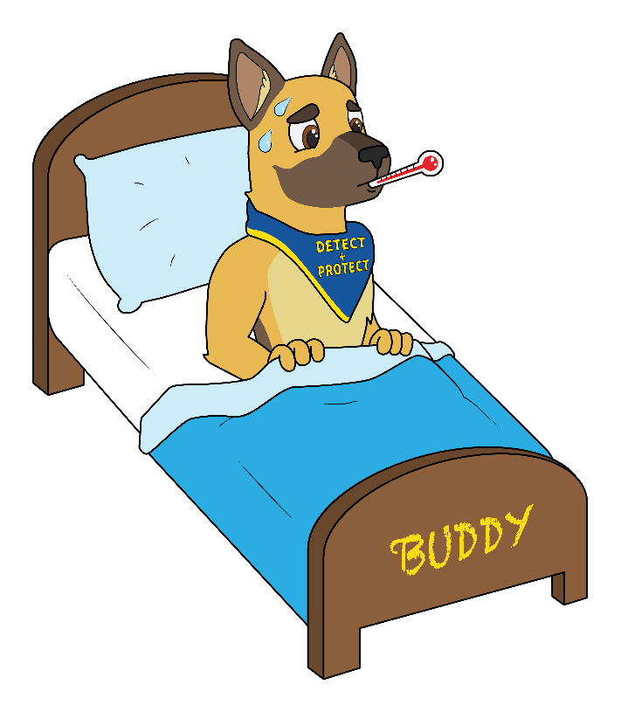

What can we see here?

Slide 30

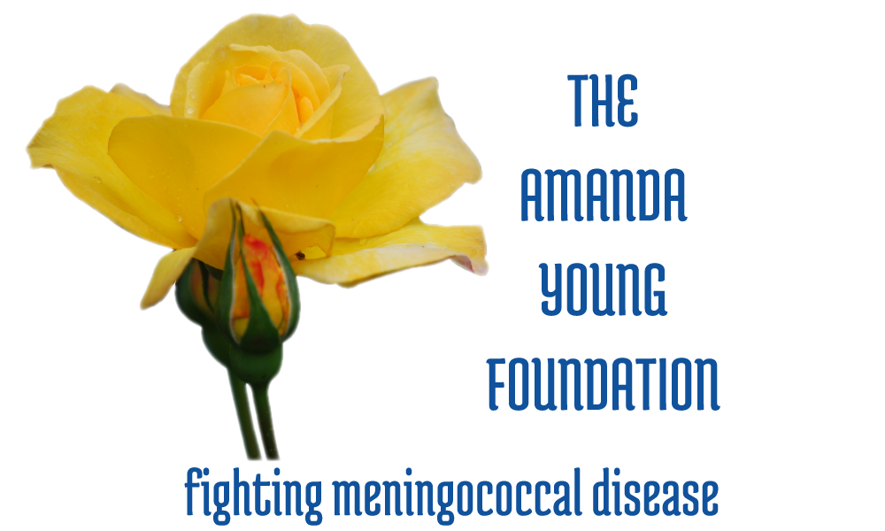
Stay well everyone.
Remember to DETECT and PROTECT.

